Slide 1

Faint features in
isolated galaxies.
Pablo Ramírez Moreta
Advisors:
Lourdes Verdes-Montenegro (IAA) Stéphane Leon Tanne (ESO/JAO)
IV Jornadas de Doctorado IAA January 29th, 2016
Collaborators:
Javier Blasco-Herrera, Mirian Fernández-Lorenzo & rest of AMIGA Team at IAA + Min Yun (UMass) + Roberto Rampazzo (INAF) + Reynier Peletier (Kapteyn Inst.) + Gijs Verdoes-Kleijn (Kapteyn Inst.) + Aku Venhola (Kapteyn Inst.)

Slide 2
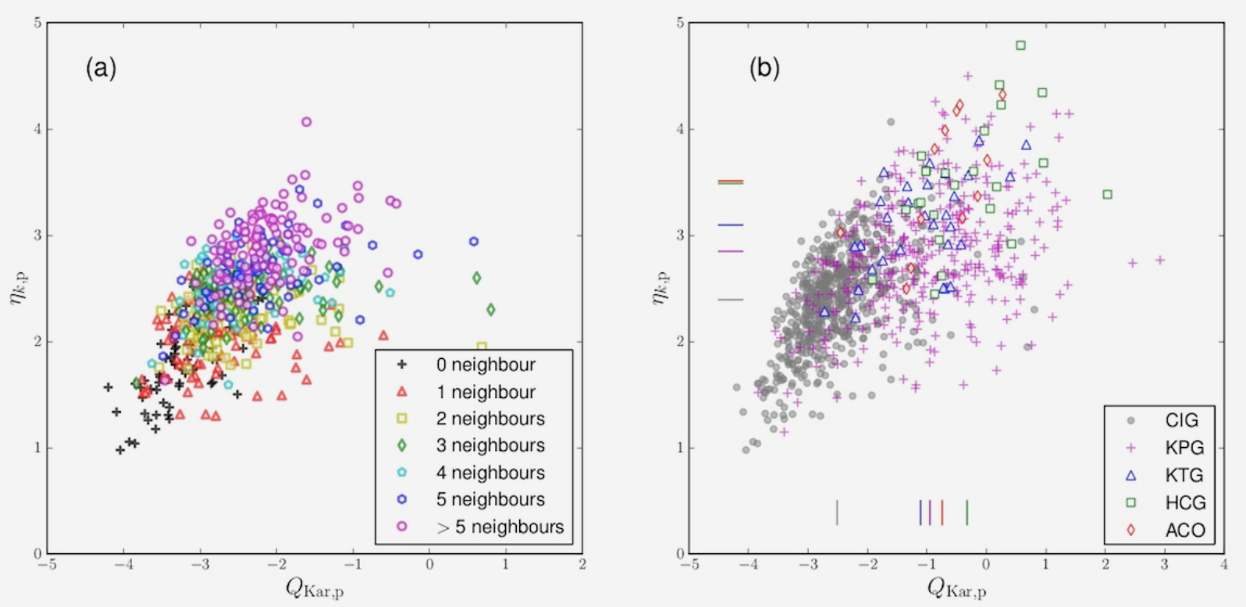
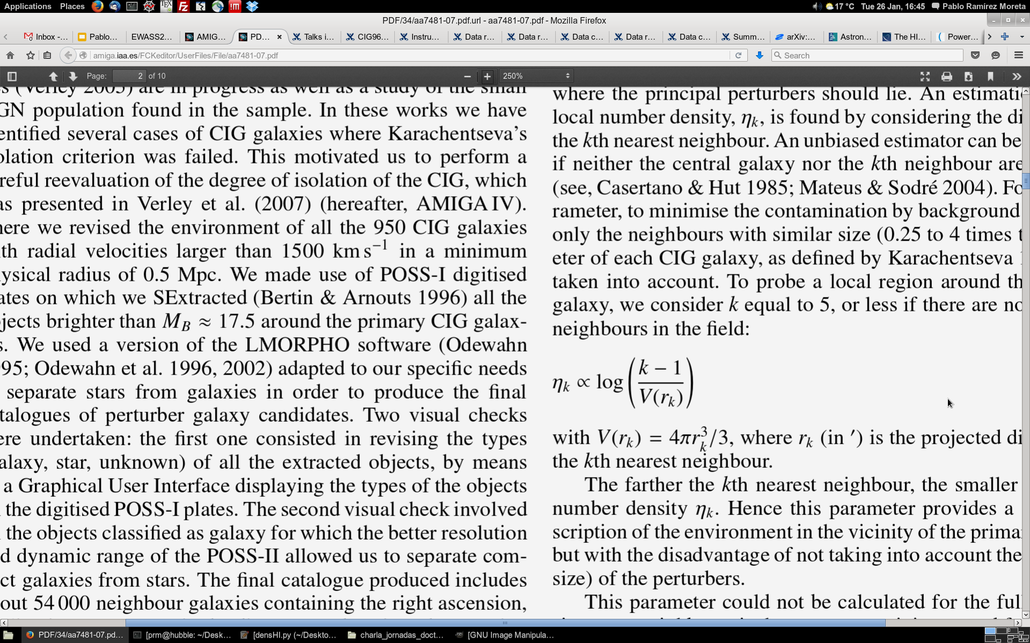
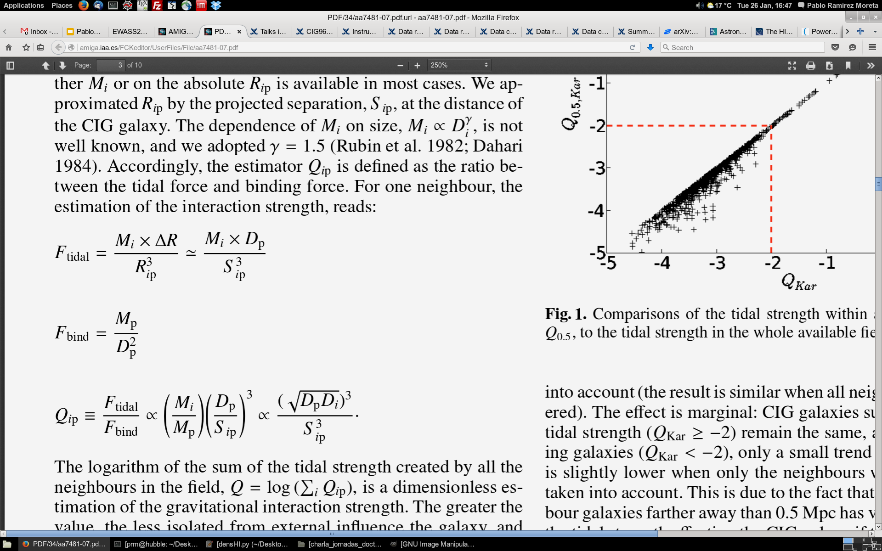
AMIGA | project description
AMIGA = Analysis of the interstellar Medium of Isolated GAlaxies
multiwavelength study
CIG Karachentseva 1973
isolation criteria:
1) local number density η_{k}
2) tidal force estimation Q_{k}
Argudo-Fernández+ 2013
local number
density
tidal force
estimation
Verley+ 2007b

Slide 3
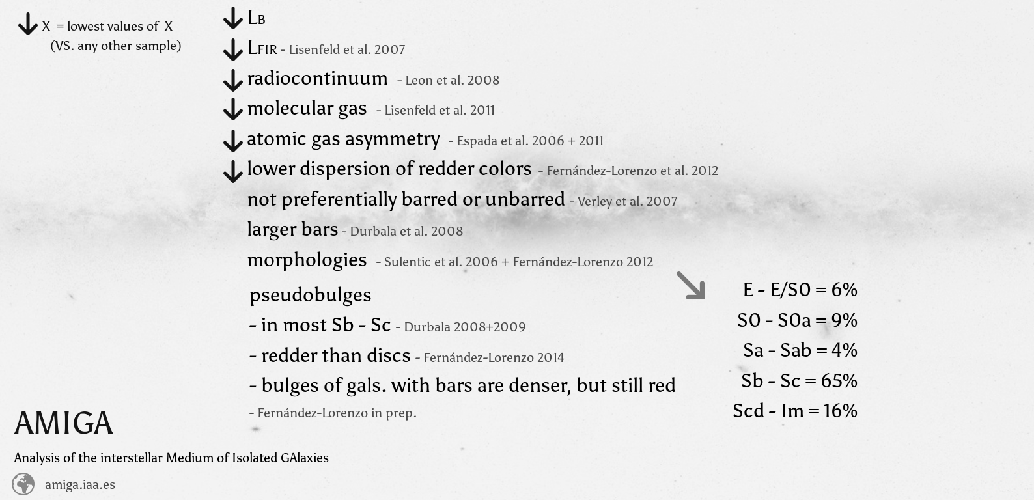
AMIGA | project description

Slide 4
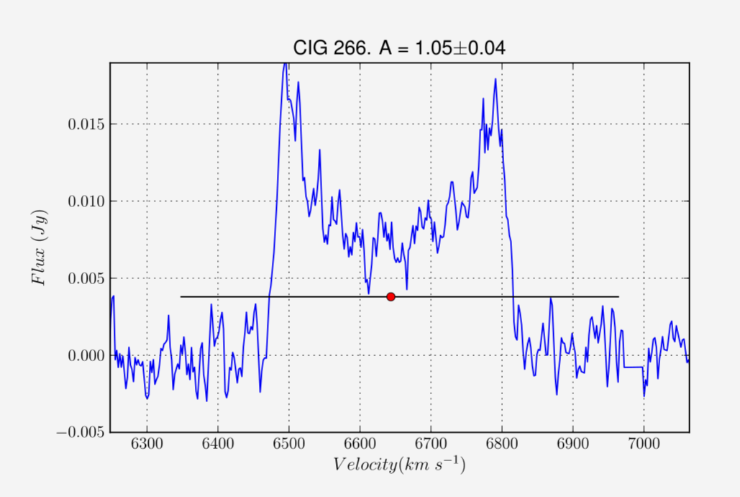
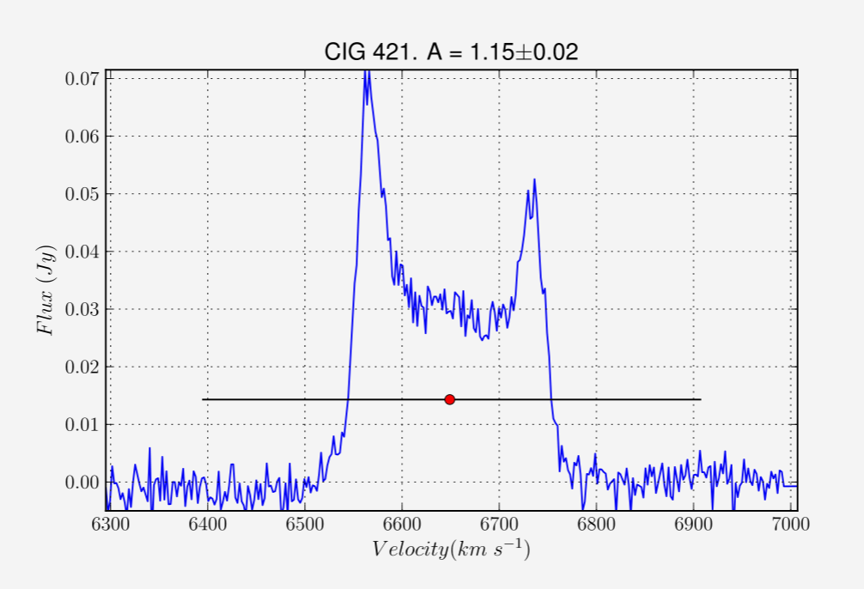
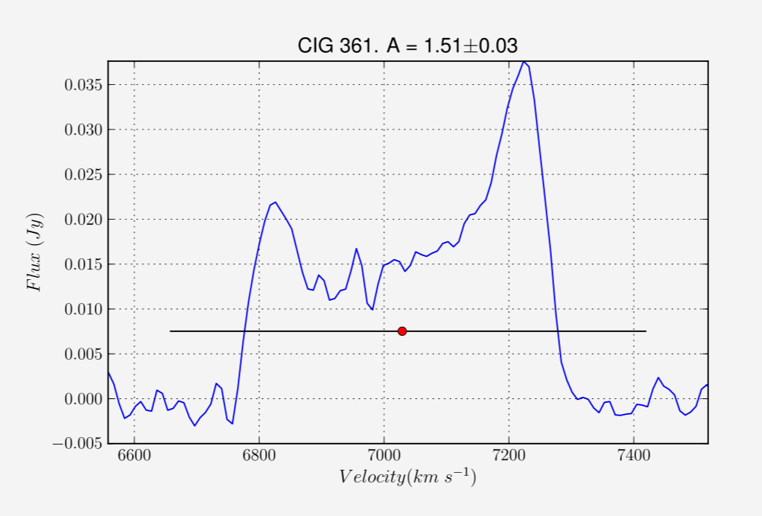
Thesis motivation | HI asymmetries in isolated galaxies
Flux (Jy)
atomic gas asymmetry in the integrated profiles Espada+ 2006, 2011
Velocity (km/s)
Espada+ 2011
5% 15% 51%
OMG!

Slide 5
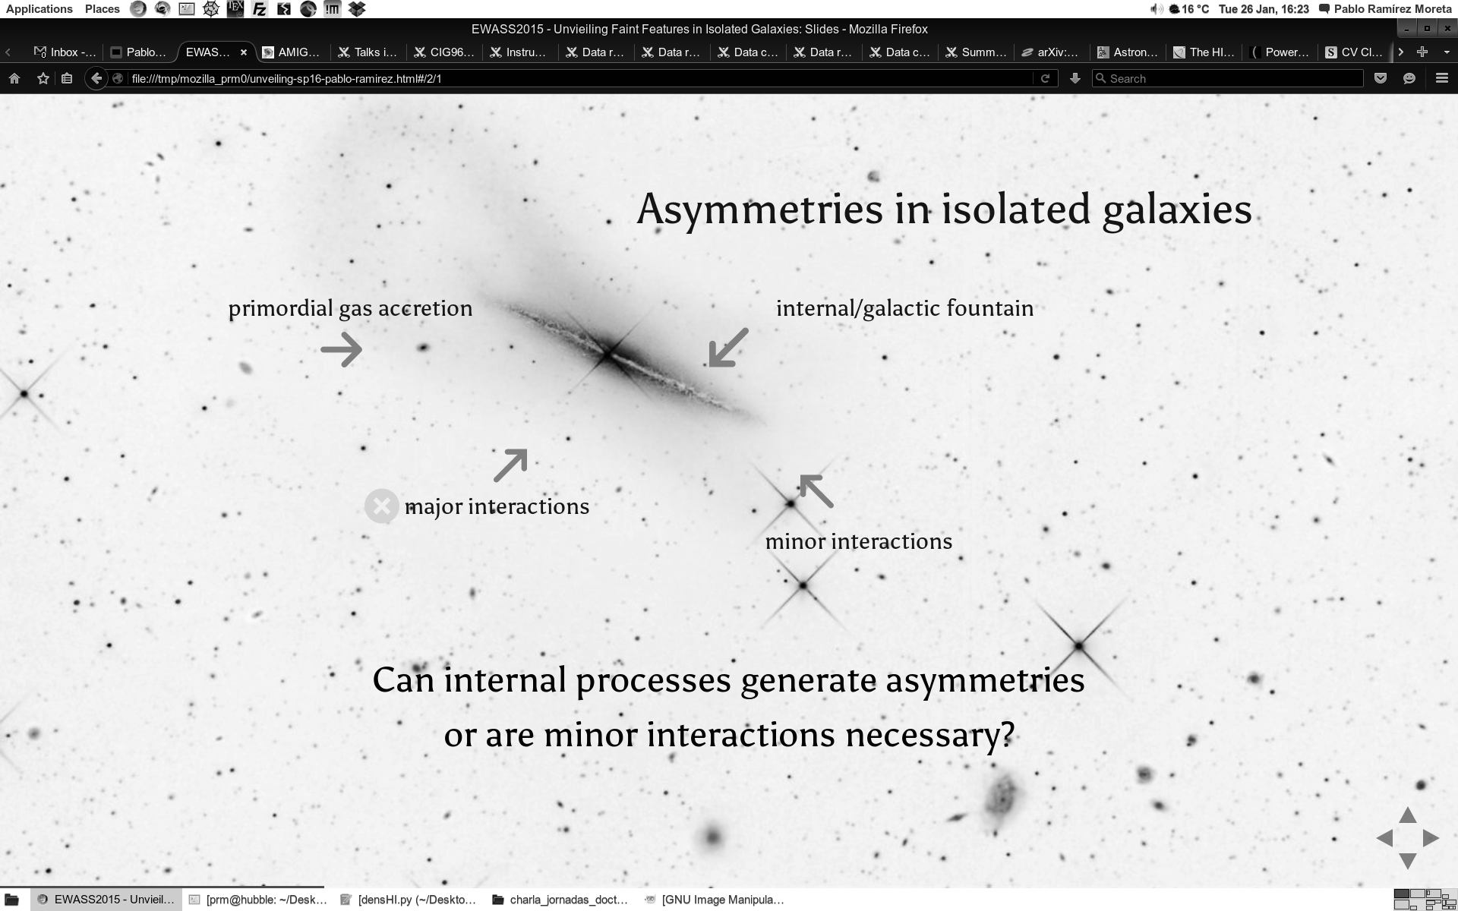
Thesis motivation | HI asymmetries in isolated galaxies
( no major interaction within last 3 Gyr )

Slide 6
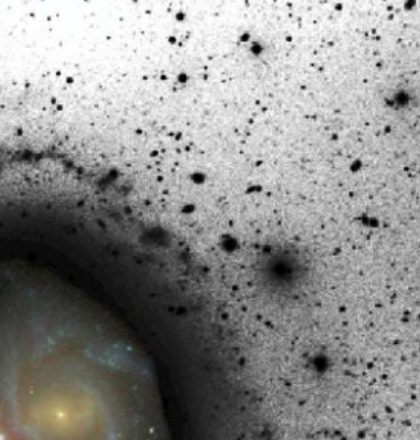
Thesis motivation | HI asymmetries in isolated galaxies
HI + optical
HI lopsided modes extinguished after 3 Gyr of isolation
faint (>> R₂₅) halo substructures may live several Gyr
Peñarrubia+ 2005
Jog & Combes+ 2009

Slide 7
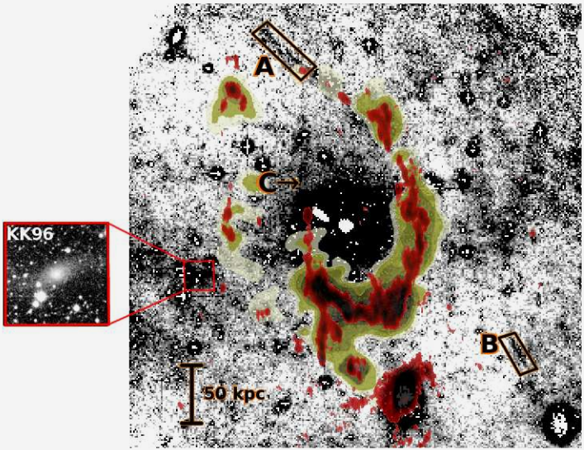
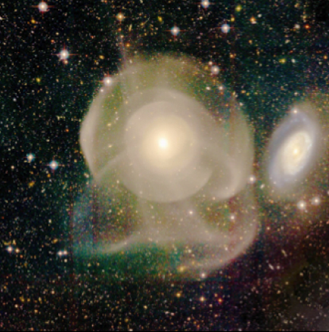
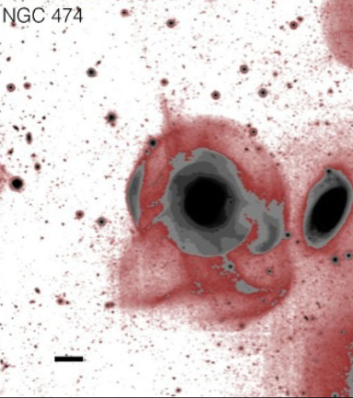
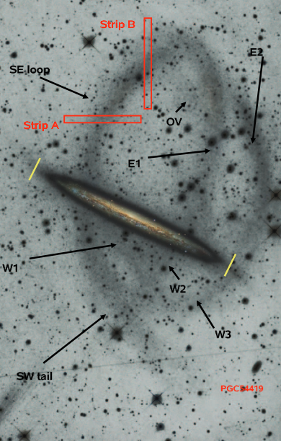
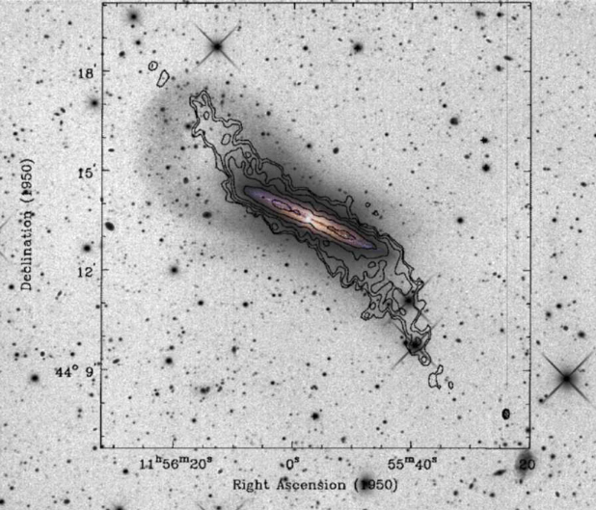
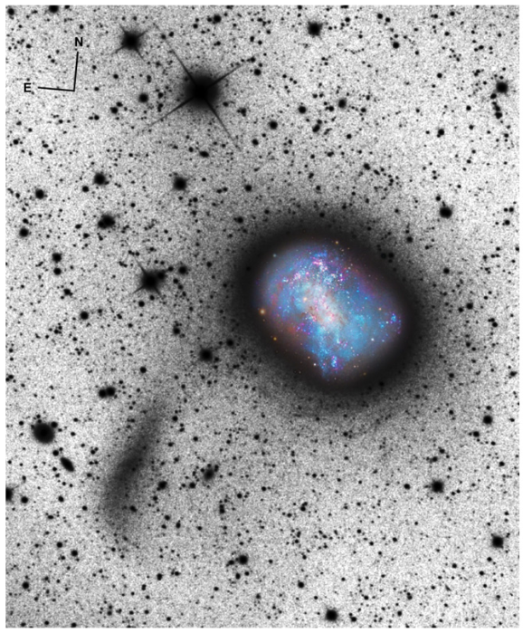
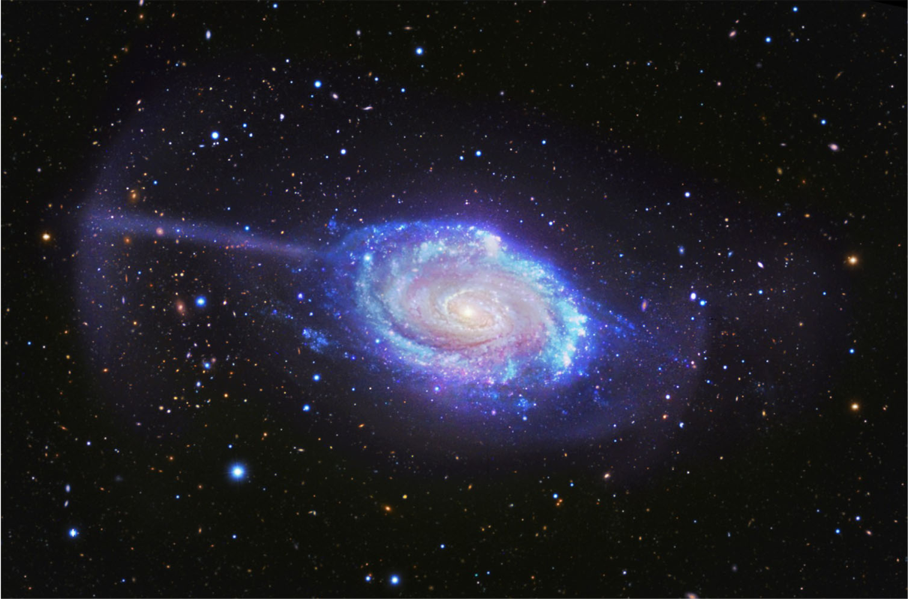
Thesis development | Existing studies
Duc et al. 2015
Watkins et al. 2014
(Leo I Group)
Foster et al. 2014
Martínez-Delgado et al. 2008, 2009, 2010, 2012

Slide 8
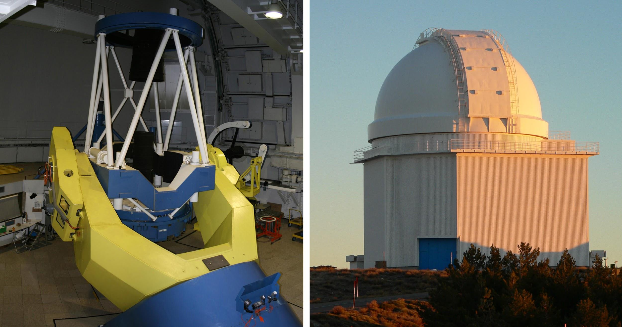
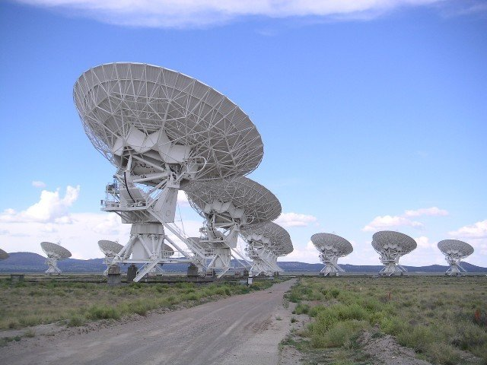
Thesis development | Sample and method
CIG
HI
deep optical
observations
(CAHA, INT, NOT, VST)
η _{k}​​< 2.7
V > 1500 km/s
22 CIG observed
(> 4h on target)
A_{G} < 0.5 mag
D₂₅ > 1 arcmin
184
isolated
galaxies
radiointerferometric
observations
(VLA, WSRT, GMRT)

Slide 9
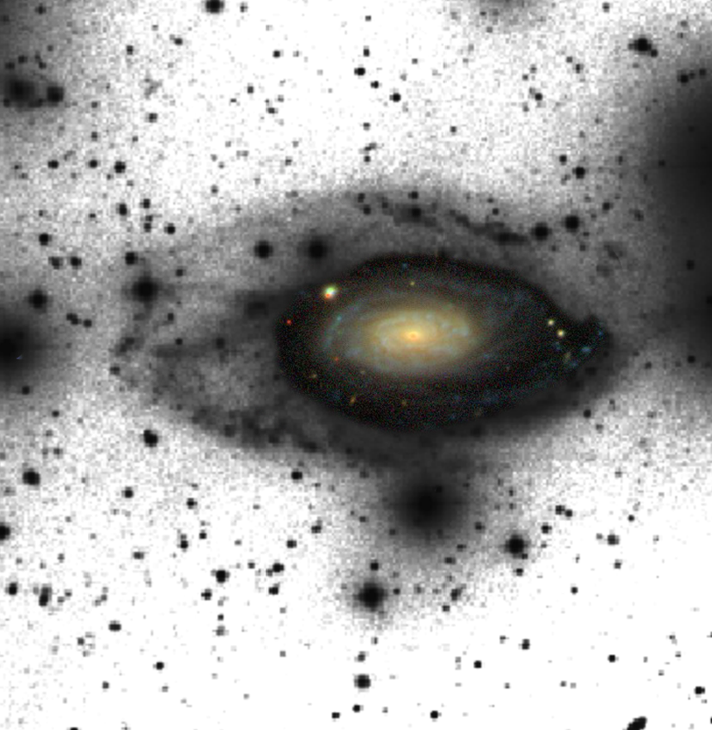
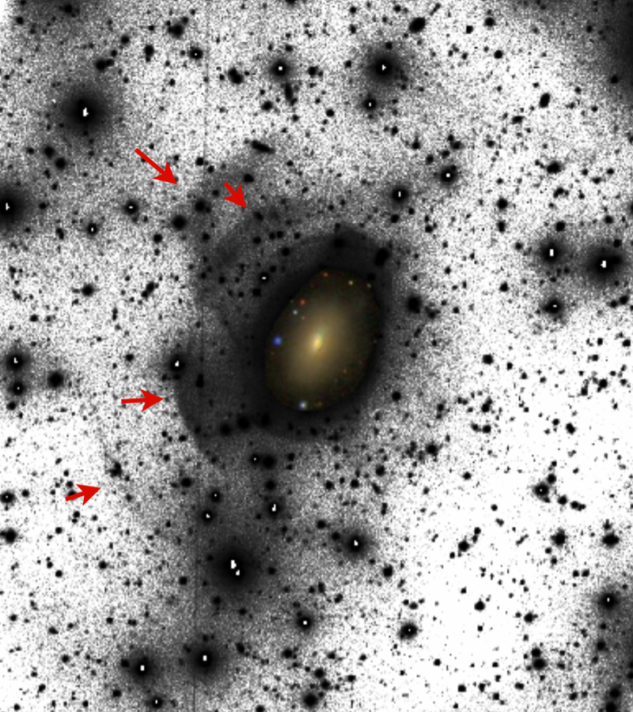
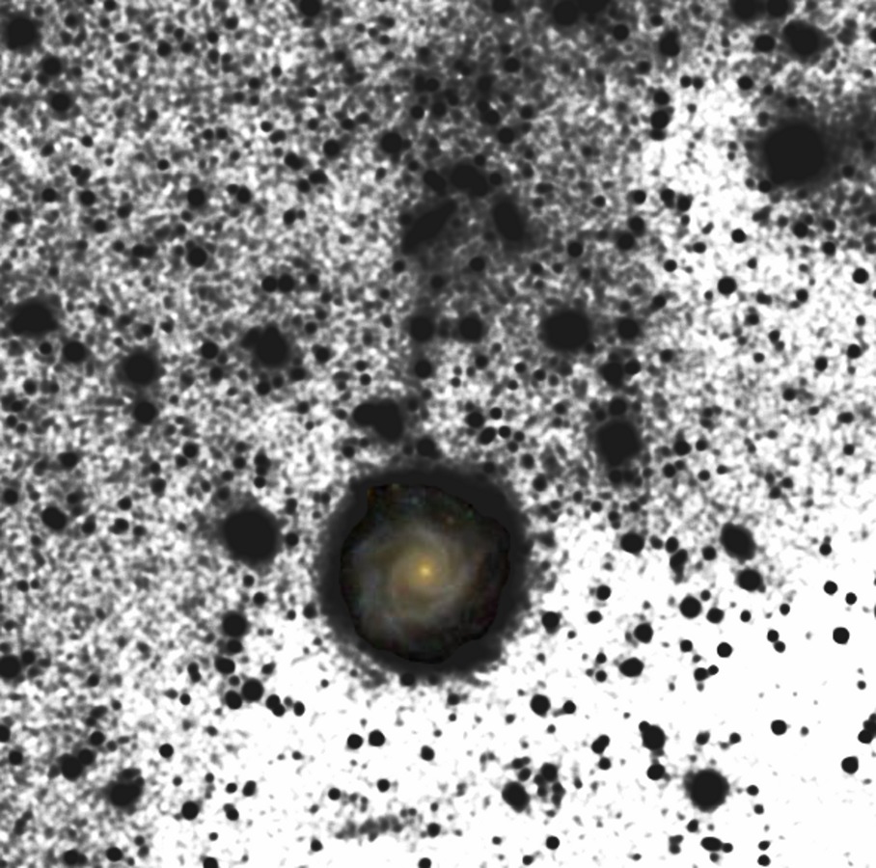
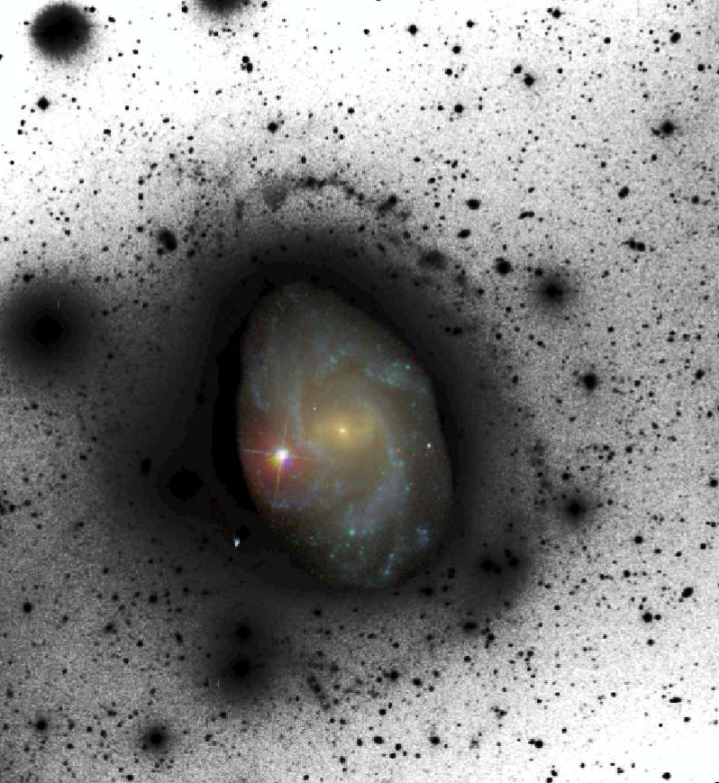
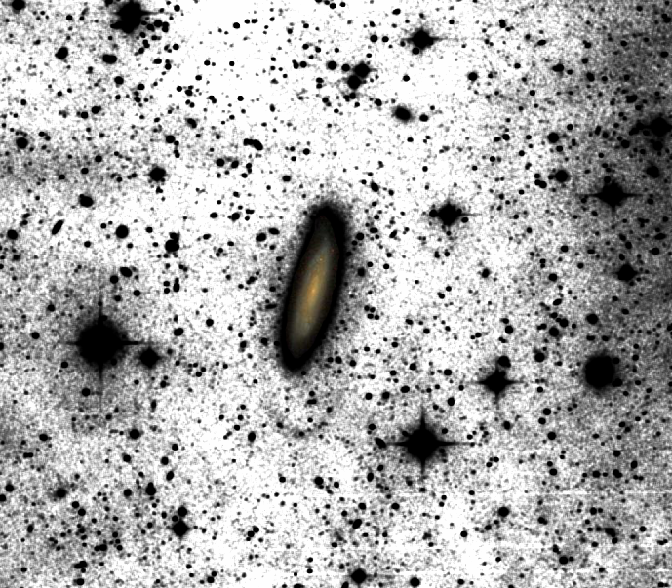
Thesis development | First images
CIG1019 (Sc)
A = 1.22
CIG841 (S0)
A = unknown
CIG568 (Scd)
A = 1.08
CAHA2.2m
~26.5 mag/"² (R band)
~2.5h on target - 6'x6', R₂₅ = 0.76'
CAHA2.2m
~5h on target (r SDSS)
image: 7'x9' - R₂₅ = 0.81'
OmegaCAM (VST)
~27.6 mag/"² (r SDSS)
~2h on target - 4'x5' - R₂₅ = 0.51'
CIG96 (Sc)
A = 1.16
CIG340 (Sbc)
A = 1.03

Slide 10
Thesis development | First images
CIG1019 (Sc) A = 1.22
CIG841 (S0) A = unknown
CIG568 (Scd) A = 1.08
inner 6' x 6'
(TOS~2.5h) SB ~26.5 mag/"² (R band)
inner 7' x 9'
Athanassoula & Bosma 1985
inner 4'x5' + FOCUS Team + AstroWISE
(TOS~2h) SB = 27.6 mag/"² (r SDSS)

Slide 11
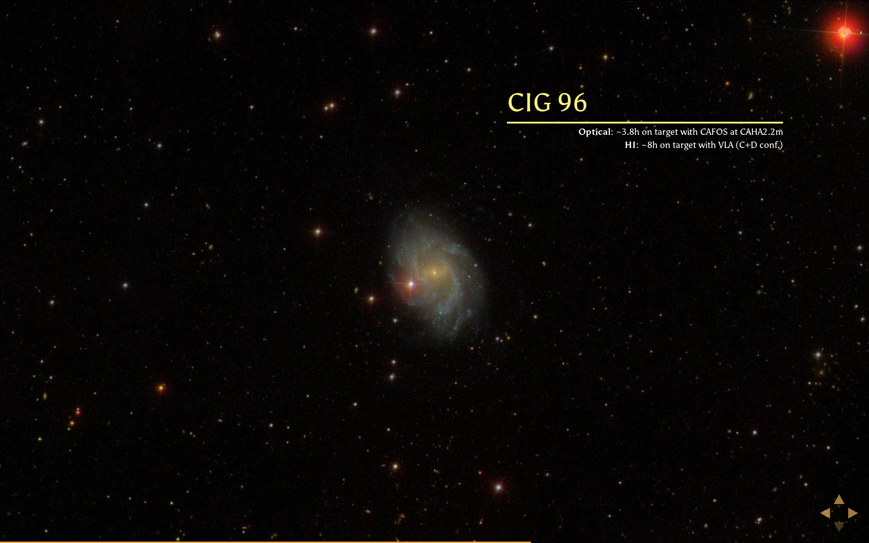
Thesis development | CIG96
( A = 1.16 )
Optical: TOS ~3.8h, CAFOS @ CAHA2.2m
SB = 26.9 mag/arcsec² (R band)
Espada+ 2005, 2011

Slide 12
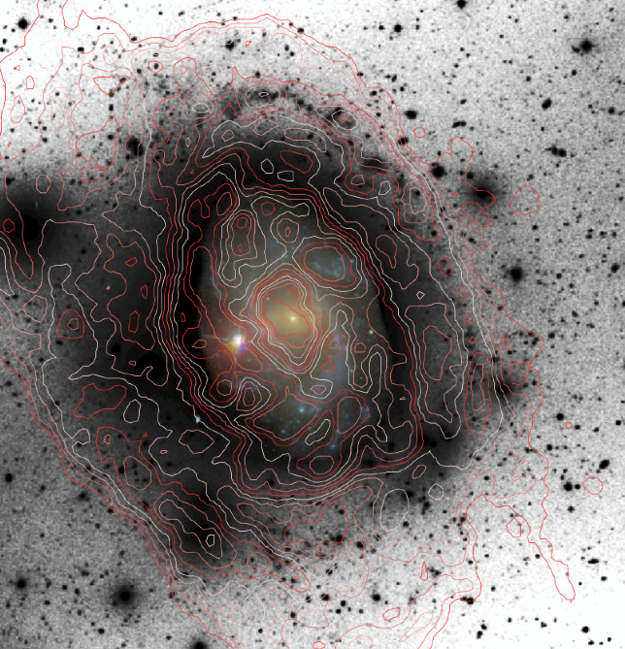
Thesis development | CIG96
( A = 1.16 )
Optical: TOS ~3.8h, CAFOS @ CAHA2.2m
HI:
TOS ~9h, VLA (C+D conf.)
SB = 26.9 mag/arcsec² (R band)

Slide 13
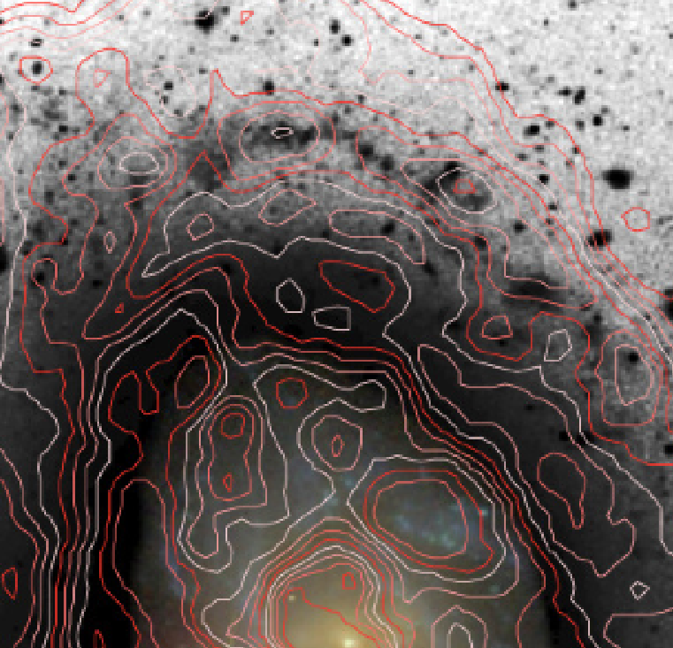
Thesis development | CIG96
( A = 1.16 )
Optical: TOS ~3.8h, CAFOS @ CAHA2.2m
HI:
TOS ~9h, VLA (C+D conf.)
Integrated HI profile
beam 16 x 11 arcsec²
N_{HI} = 5 x 10¹⁹ cm⁻² (5σ)
Espada+ 2005, 2011

Slide 14
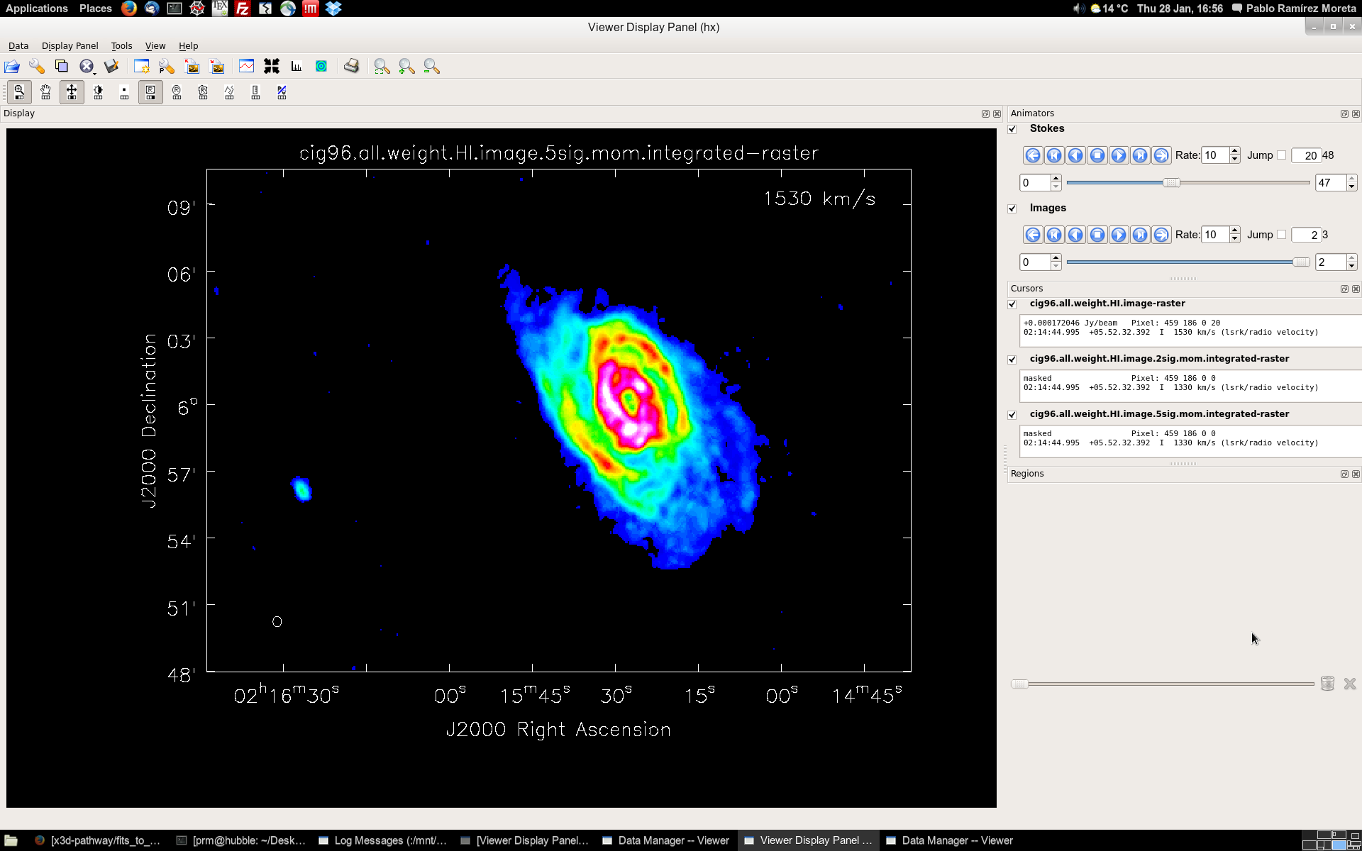
Thesis development | CIG96
( A = 1.16 )
HI:
TOS ~9h, VLA (C+D conf.)
TOS ~10h, EVLA (C+D conf.)
HI:
TOS ~9h, VLA (C+D conf.)
TOS ~10h, EVLA (C+D conf.)
Integrated HI profile (0th moment)
5σ masking
beam 28 x 28 arcsec²
N_{HI} = 1.8 x 10¹⁹ cm⁻² (5σ)
Ramírez Moreta+ in prep.

Slide 15
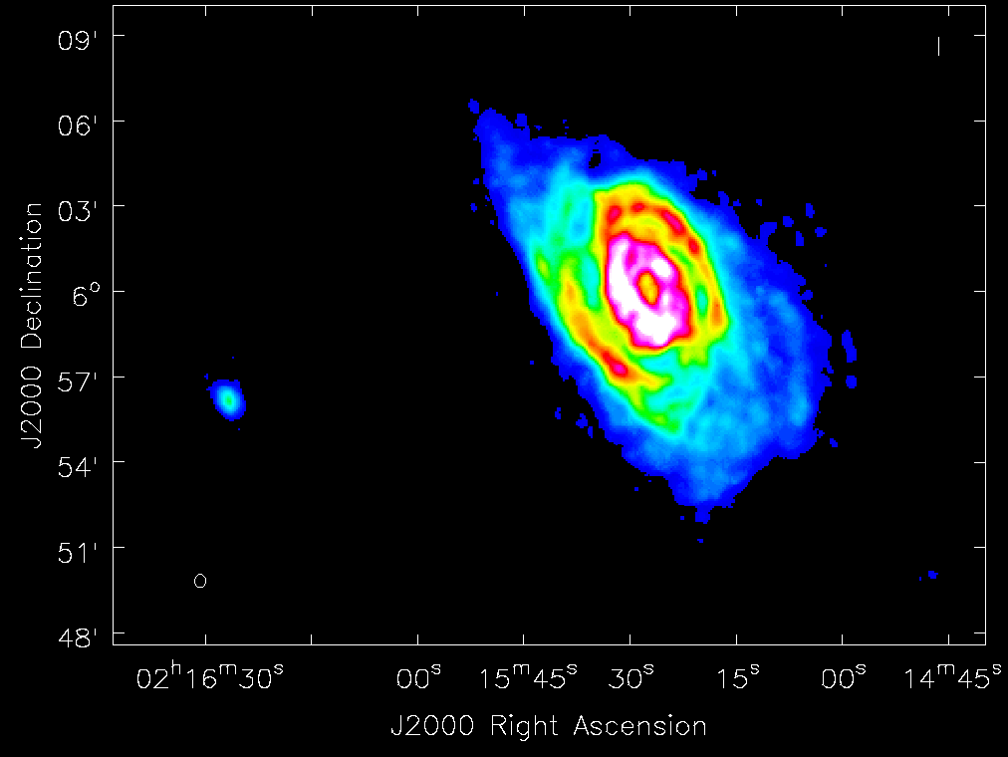
Thesis development | CIG96
( A = 1.16 )
HI:
TOS ~9h, VLA (C+D conf.)
TOS ~10h, EVLA (C+D conf.)
HI:
TOS ~9h, VLA (C+D conf.)
TOS ~10h, EVLA (C+D conf.)
Integrated HI profile (0th moment)
WT & 5σ masking
beam 28 x 28 arcsec²
N_{HI} = 0.9 x 10¹⁹ cm⁻² (5σ)
Ramírez Moreta+ in prep.

Slide 16
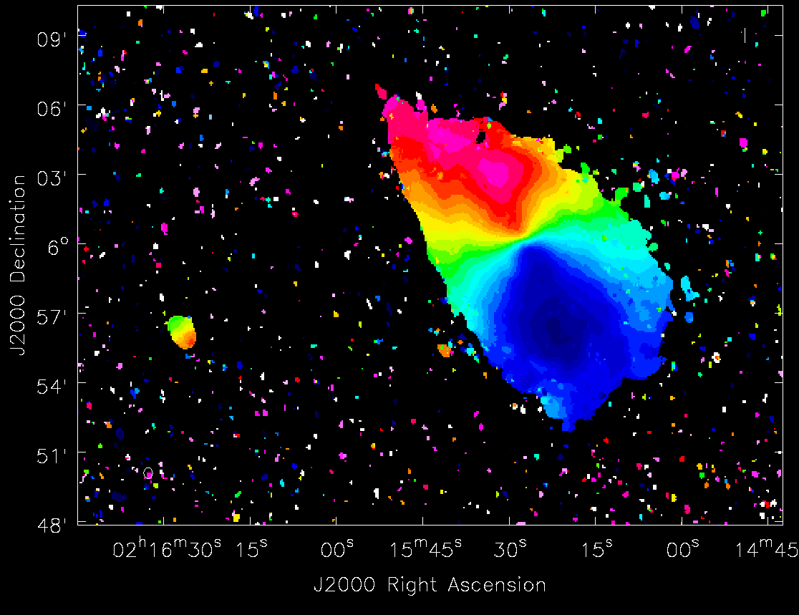
Thesis development | CIG96
( A = 1.16 )
HI:
TOS ~9h, VLA (C+D conf.)
TOS ~10h, EVLA (C+D conf.)
HI:
TOS ~9h, VLA (C+D conf.)
TOS ~10h, EVLA (C+D conf.)
Velocity field (1st moment) & PV cuts
WT & 5σ masking
Ramírez Moreta+ in prep.

Slide 17
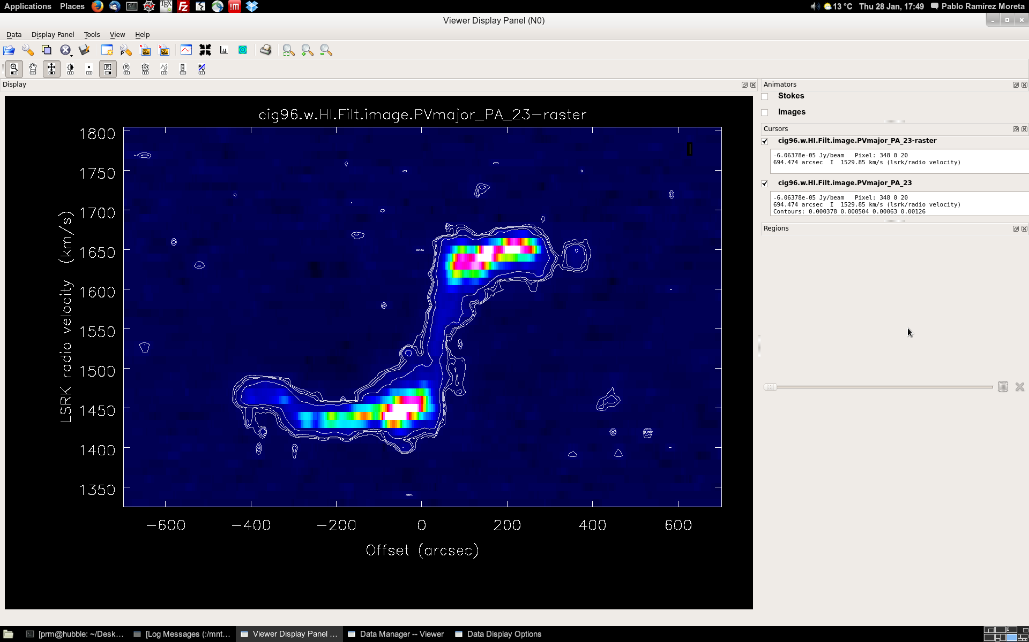
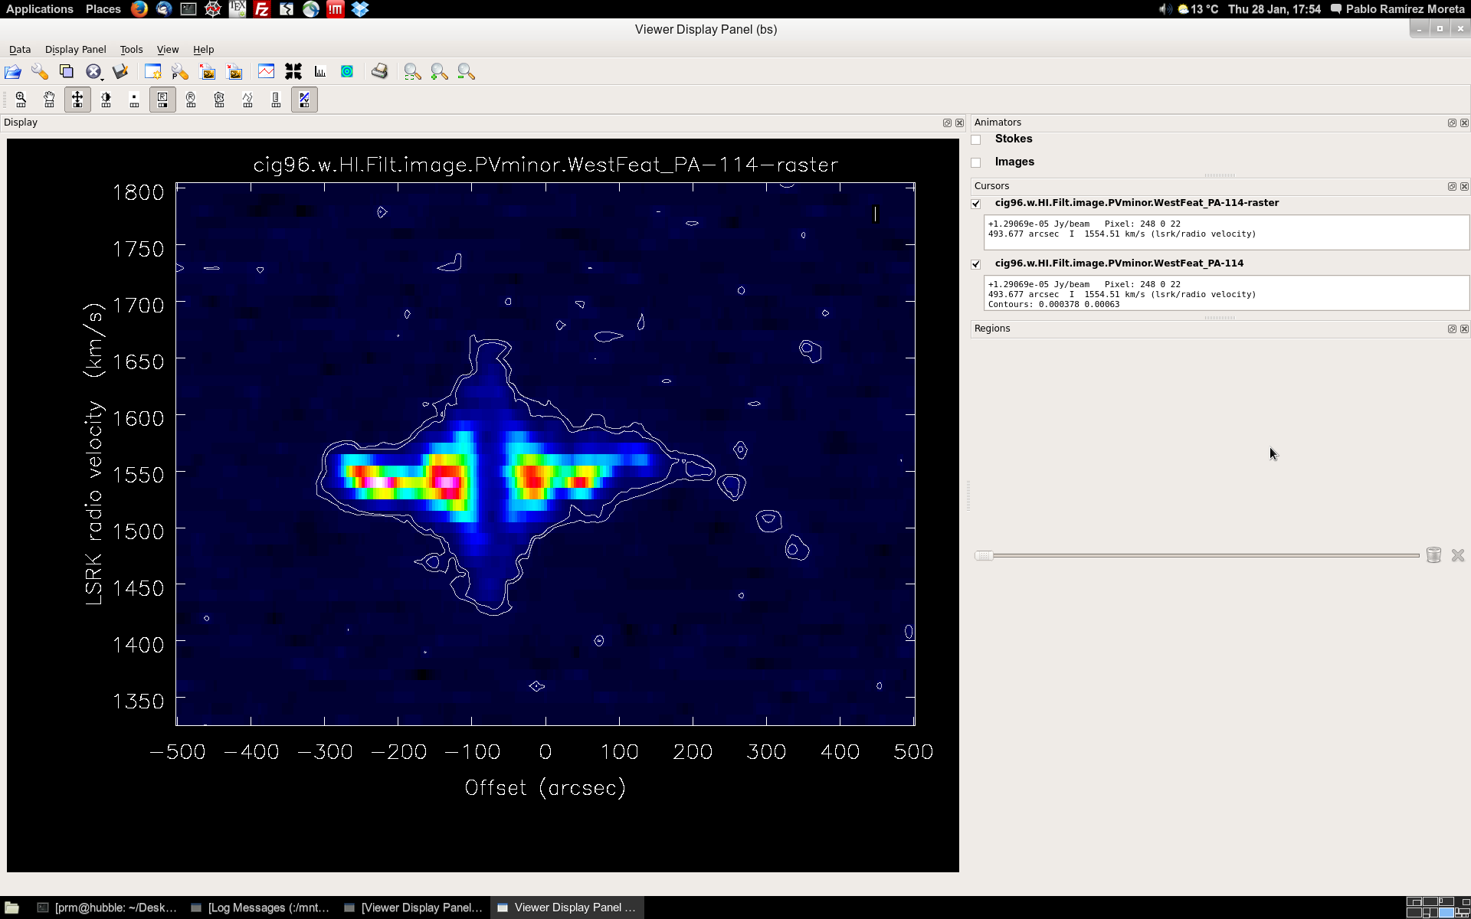
Thesis development | CIG96
( A = 1.16 )
HI:
TOS ~9h, VLA (C+D conf.)
TOS ~10h, EVLA (C+D conf.)
PV cut - major axis
PV cut - minor axis
Ramírez Moreta+ in prep.

Slide 18
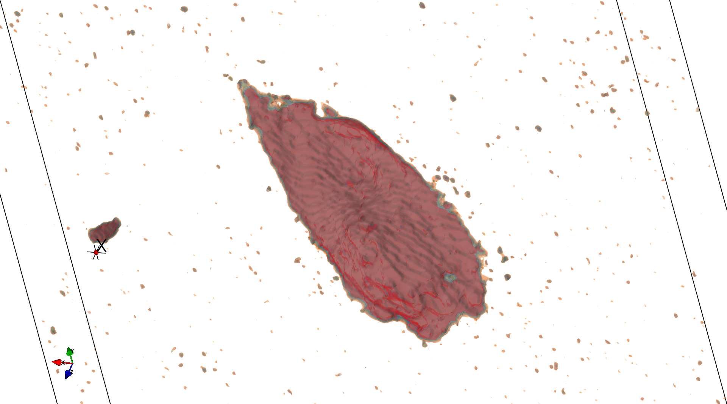
Thesis development | CIG96
( A = 1.16 )
HI:
TOS ~9h, VLA (C+D conf.)
TOS ~10h, EVLA (C+D conf.)
script by
Vogt+ 2013

Slide 19
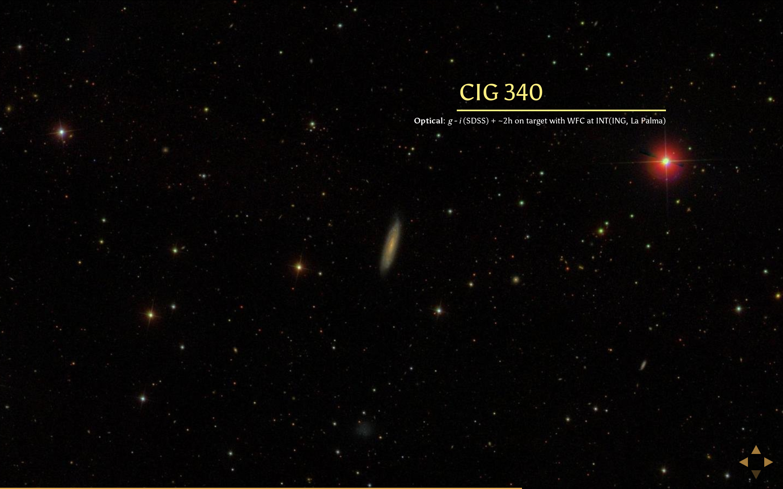
Thesis development | CIG340
( A = 1.03 )
Optical:
TOS ~2h (r SDSS)
(WFC at INT-ING, La Palma)

Slide 20
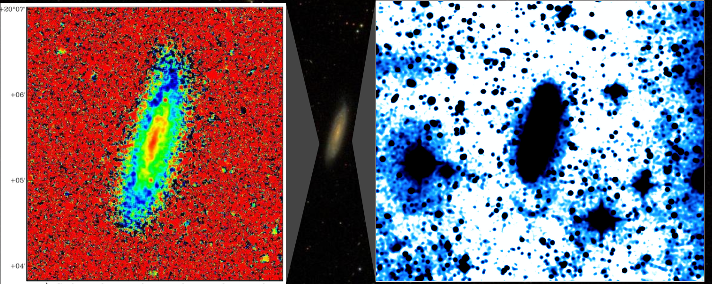
Thesis development | CIG340
( A = 1.03 )
Optical:
TOS ~2h (r SDSS)
(WFC at INT-ING, La Palma)
g-i SDSS, inner 3’ x 3’
inner 9' x 9' … ongoing work
Scott+ 2014

Slide 21
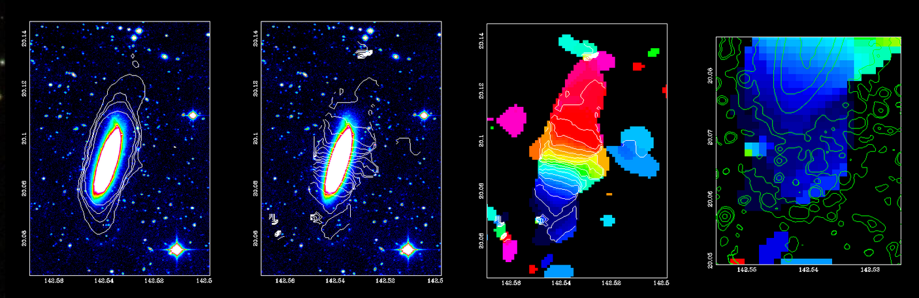
Thesis development | CIG340
( A = 1.03 )
Optical:
TOS ~2h (r SDSS)
(WFC at INT-ING, La Palma)
HI contours Isovelocity contours Velocity field
Scott+ 2014

Slide 22
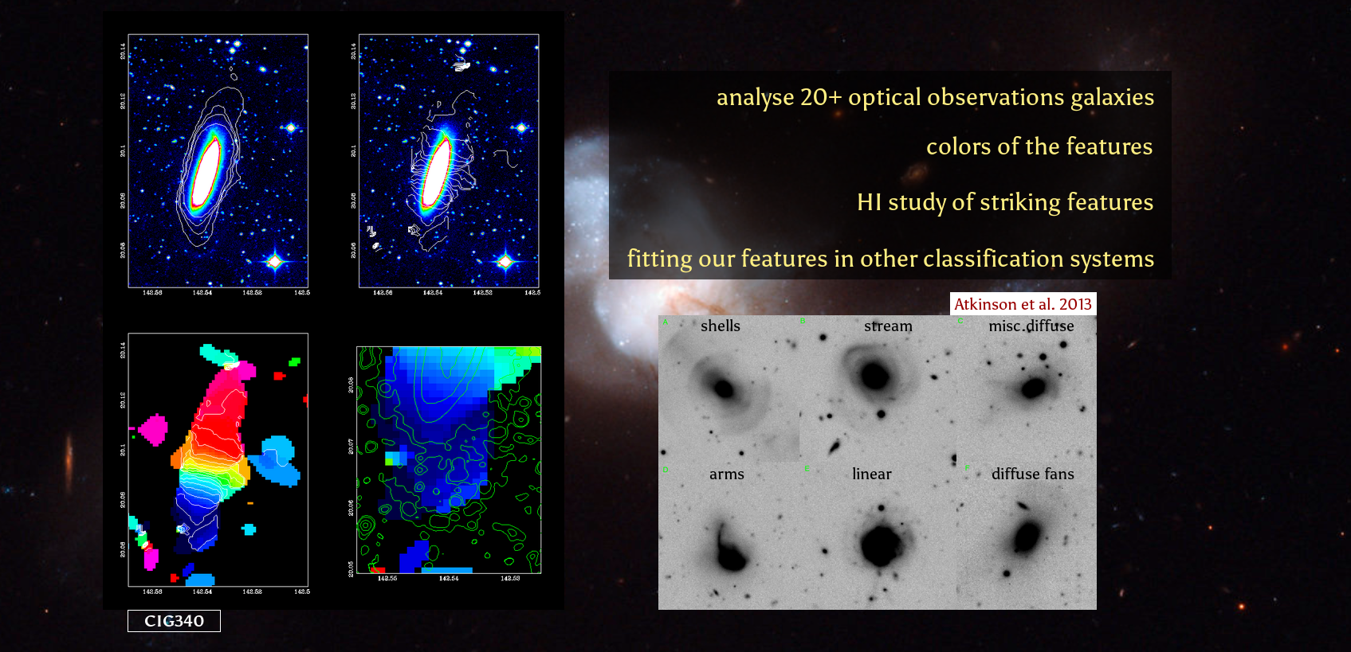
Thesis development | Work to come...
Thank you!

Slide 23
Faint features in
isolated galaxies.
Pablo Ramírez Moreta
Advisors:
Lourdes Verdes-Montenegro (IAA) Stéphane Leon Tanne (ESO/JAO)
IV Jornadas de Doctorado IAA January 29th, 2016

Slide 24
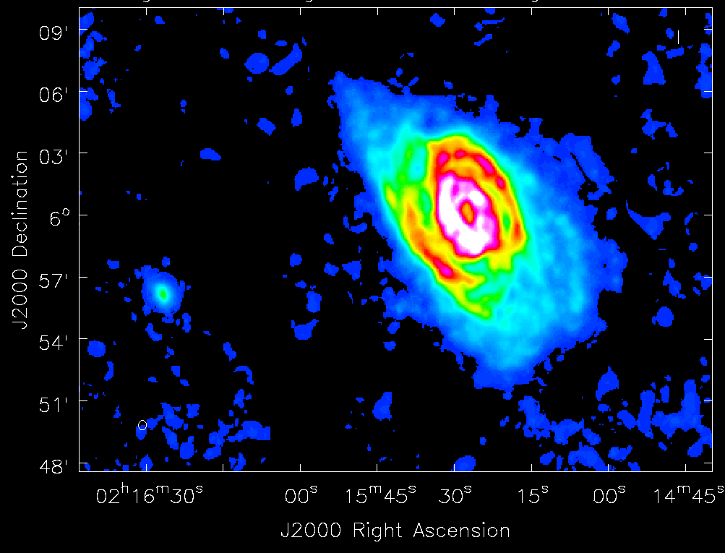
Thesis development | CIG96
( A = 1.16 )
HI:
TOS ~9h, VLA (C+D conf.)
TOS ~10h, EVLA (C+D conf.)
HI:
TOS ~9h, VLA (C+D conf.)
TOS ~10h, EVLA (C+D conf.)
Integrated HI profile (0th moment)
WT & 2σ masking
beam 28 x 28 arcsec²
N_{HI} = 0.9 x 10¹⁹ cm⁻² (5σ)

Slide 25
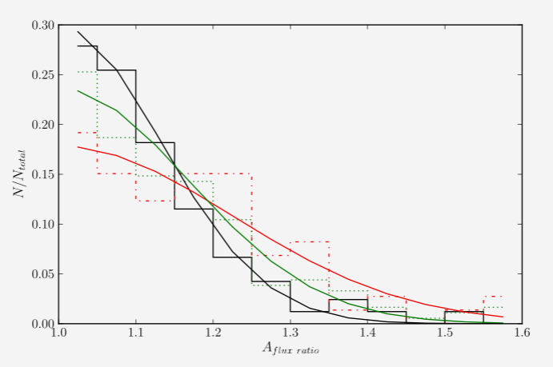
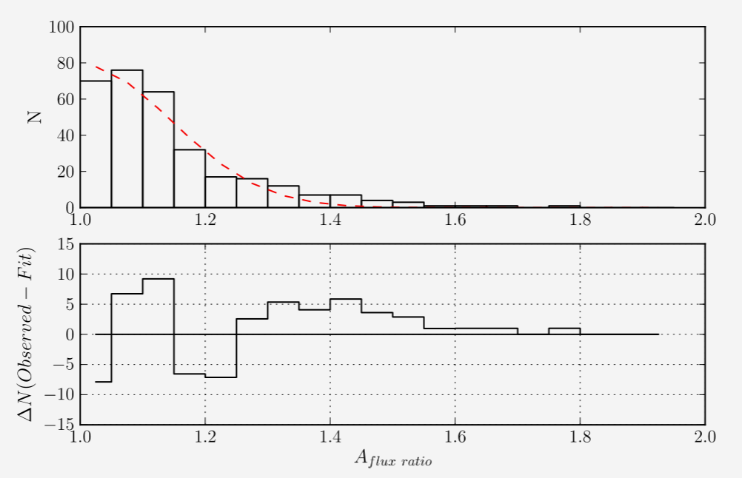
Thesis motivation | HI asymmetries in isolated galaxies
atomic gas asymmetry in the integrated profiles Espada+ 2006, 2011
5%
15%
51%
AMIGA Bornaud 05 Bornaud 05 + Haynes 98 + Matthews 98 - CIG
Normalized count
Asymmetry Flux ratio

